Slide 1
SECURE DATA HIDING IN IMAGES USING STEGANOGRAPHY
CAPSTONE PROJECT
Presented By: Nikhil Bhandari
Student Name : Nikhil Bhandari
College Name & Department : Dr. Vishwanath Karad MIT World Peace University, MCA

Slide 2
OUTLINE
Problem Statement
Technology used
Wow factor
End users
Result
Conclusion
Git-hub Link
Future scope

Slide 3
Problem Statement
Traditional data transmission methods are vulnerable to interception.
This project ensures secure communication by hiding messages within images using steganography.

Slide 4
Technology used
Programming Language: Python
Libraries: OpenCV, Tkinter
Platform: Windows/Linux/Mac
Security: Password-protected encoding and decoding

Slide 5
Wow factors
Windows 11-like sleek UI
Password-protected encryption
Easy-to-use graphical interface
Automatic field resets after encoding/decoding
Secure & efficient data hiding

Slide 6
End users
Security Professionals
Journalists & Whistleblowers
Private Individuals
Government Agencies

Slide 7
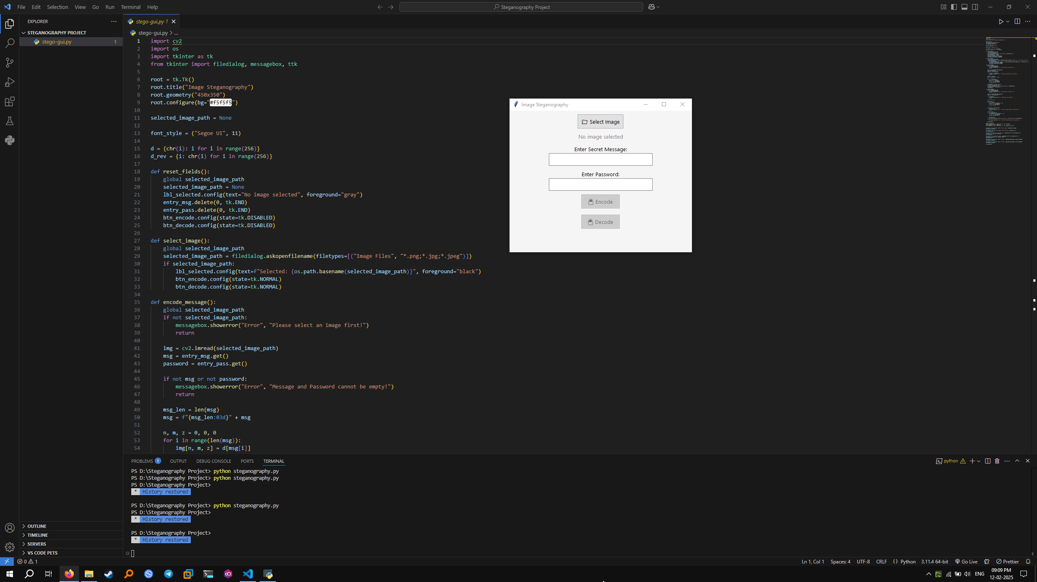
Results

Slide 8
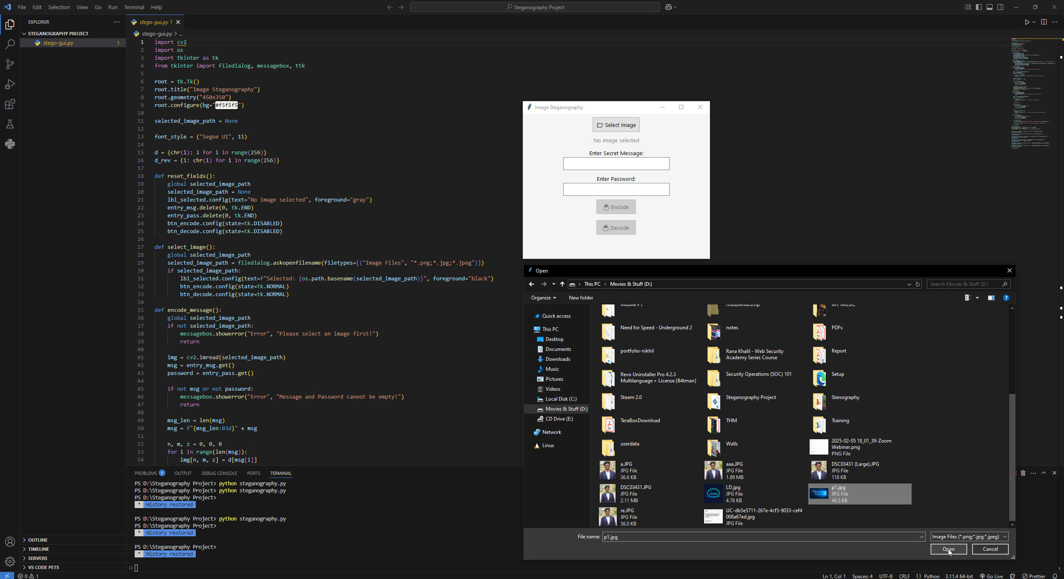
Results

Slide 9
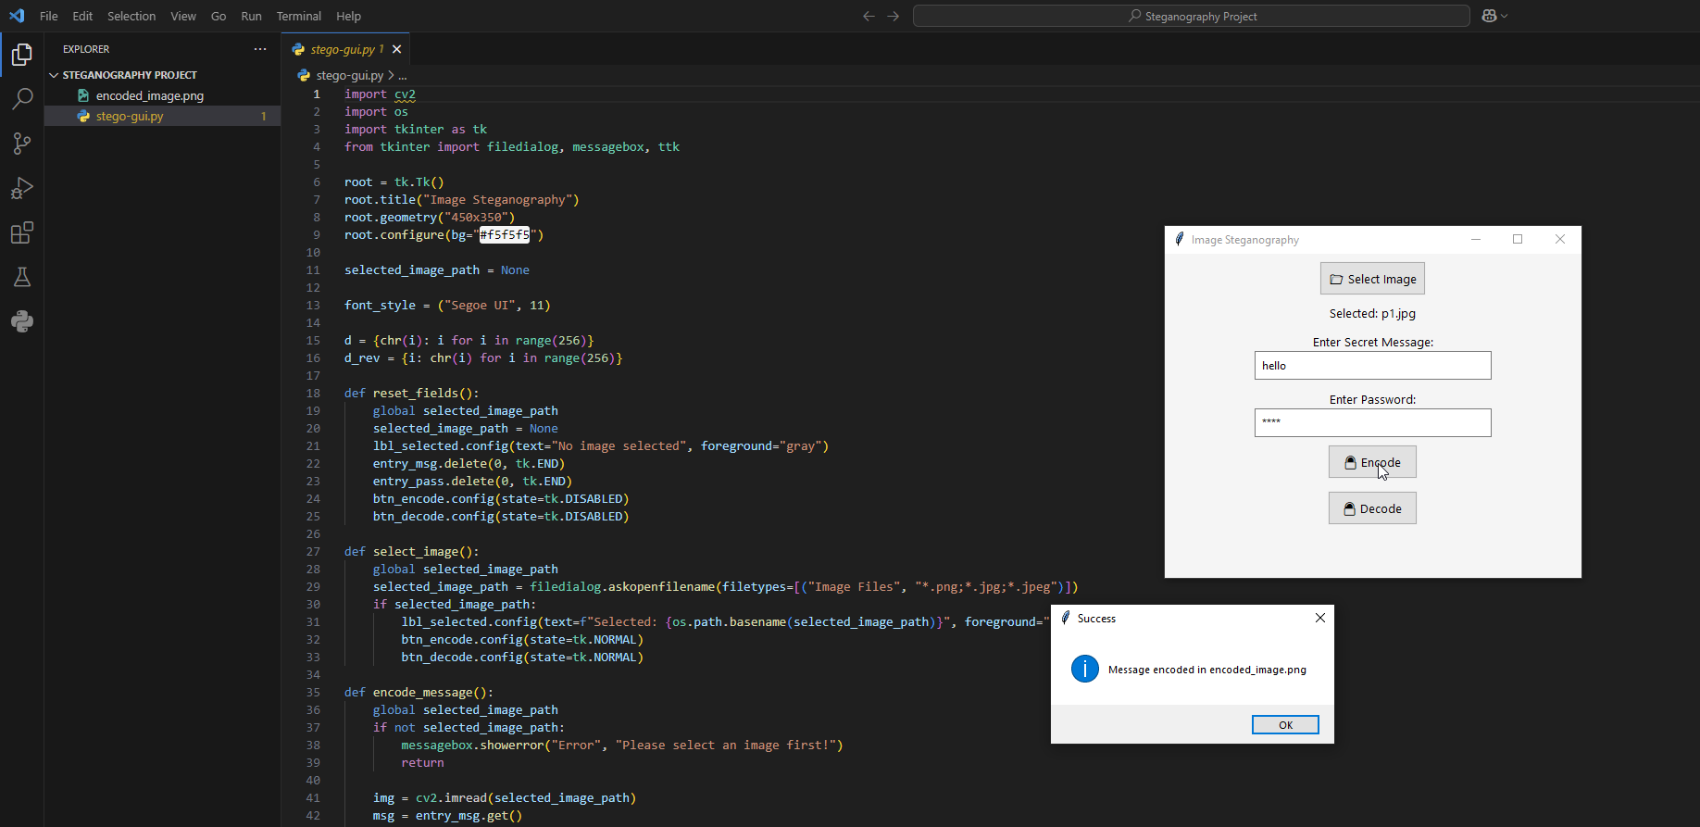
Results

Slide 10
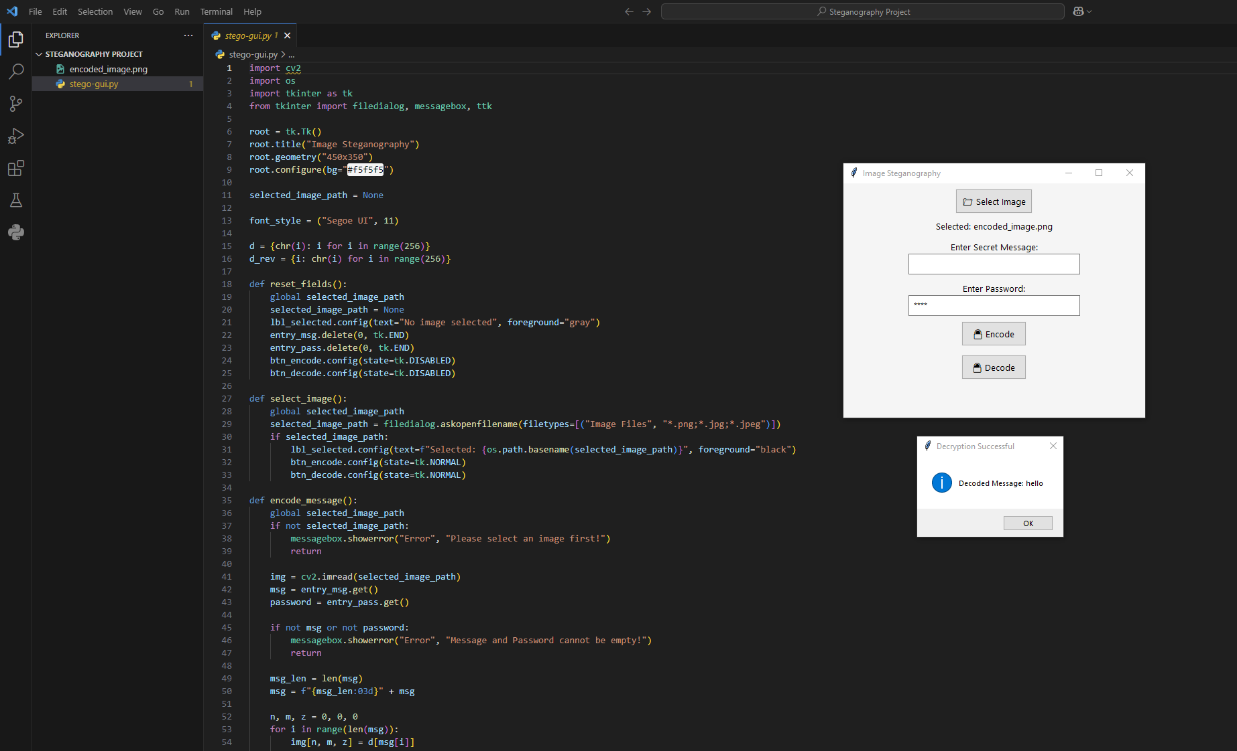

Slide 11
Conclusion
This project successfully implements steganography for secure communication. It provides a user-friendly interface for encoding and decoding messages while maintaining security.

Slide 12
GitHub Link
https://github.com/NIKHIL-WR34/Steganograpy-GUI-AICTE

Slide 13
Future scope(optional)
Implementing AES encryption for additional security
Developing a mobile version
Enhancing efficiency for larger images
AI-based image optimization

Slide 14
THANK YOU

